Slide 1
Exploring and Contrasting Classical and Machine Learning Based Portfolio Optimization Strategies
Tejal Borade, Louise Henningsson, Jharold Montoya, Chinmay Thakre, Viet Tran

Slide 2
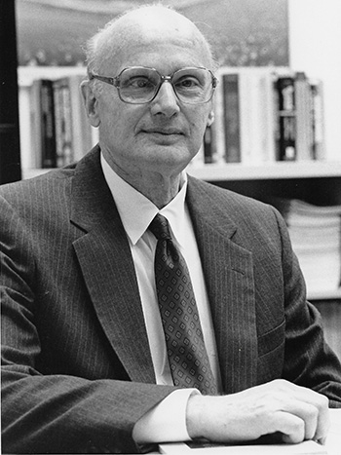
Introduction
Harry Markowitz introduces Modern Portfolio Theory in 1952, in which his model aims to:
Maximize expected returns for a given level of risk, or
Minimize risk for a targeted level of expected returns.
Despite efficiency of Markowitz model, it has limitations in capturing higher moments of return distributions.
The goal of our research is to explore various classical portfolio optimization and machine learning-based strategies.

Slide 3
Data
Daily prices (adjusted close) for a 10 year period (12/09/2013 - 12/09/2023)
2 portfolios:
Global DM Equity Portfolio (22): Canada (EWC), US (IVV), (EWO), (EWK), (EDEN), (EFNL), (EWG), Canada (EWC), US (IVV), Austria (EWO), Belgium (EWK), Denmark (EDEN), Finland (EFNL), France (EWQ), Germany (EWG), Ireland (EIRL), Israel (EIS), Italy (EWI), Netherlands (EWN), Norway (ENOR), Spain (EWP), Sweden (EWD), Switzerland (EWL), UK (EWU), Australia (EWA), Hong Kong (EWH), Japan (EWJ), New Zealand (ENZL), Singapore (EWS).
US Sectors Equity Portfolio (9): Consumer Discretionary (XLY), Consumer Staples (XLP), Energy (XLE), Finance (XLF), Health Care (XLV), Industrials (XLI), Materials (XLB), Tech (XLK), Utilities (XLU).

Slide 4
Standard optimization models
Maximum Returns portfolio
Minimum Variance portfolio
Maximum Sharpe portfolio
Maximum Decorrelation

Slide 5
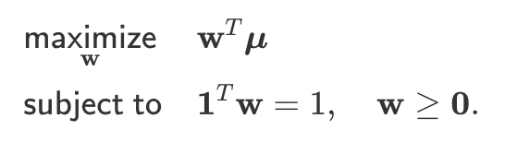
Classical Model 1: Maximal Returns
The first condition identifies the stock in our universe that has the highest returns for the given period.
The second condition ensures complete investment of our capital, with no shorts.

Slide 6
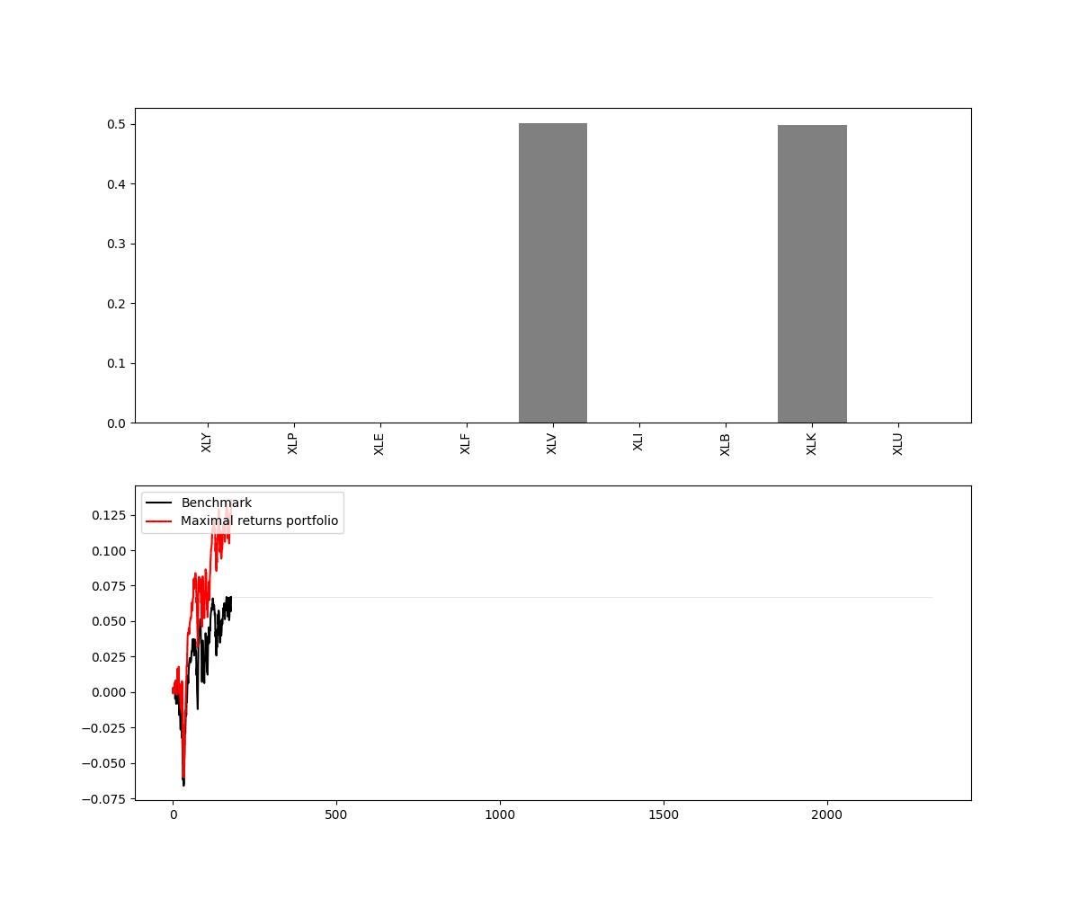
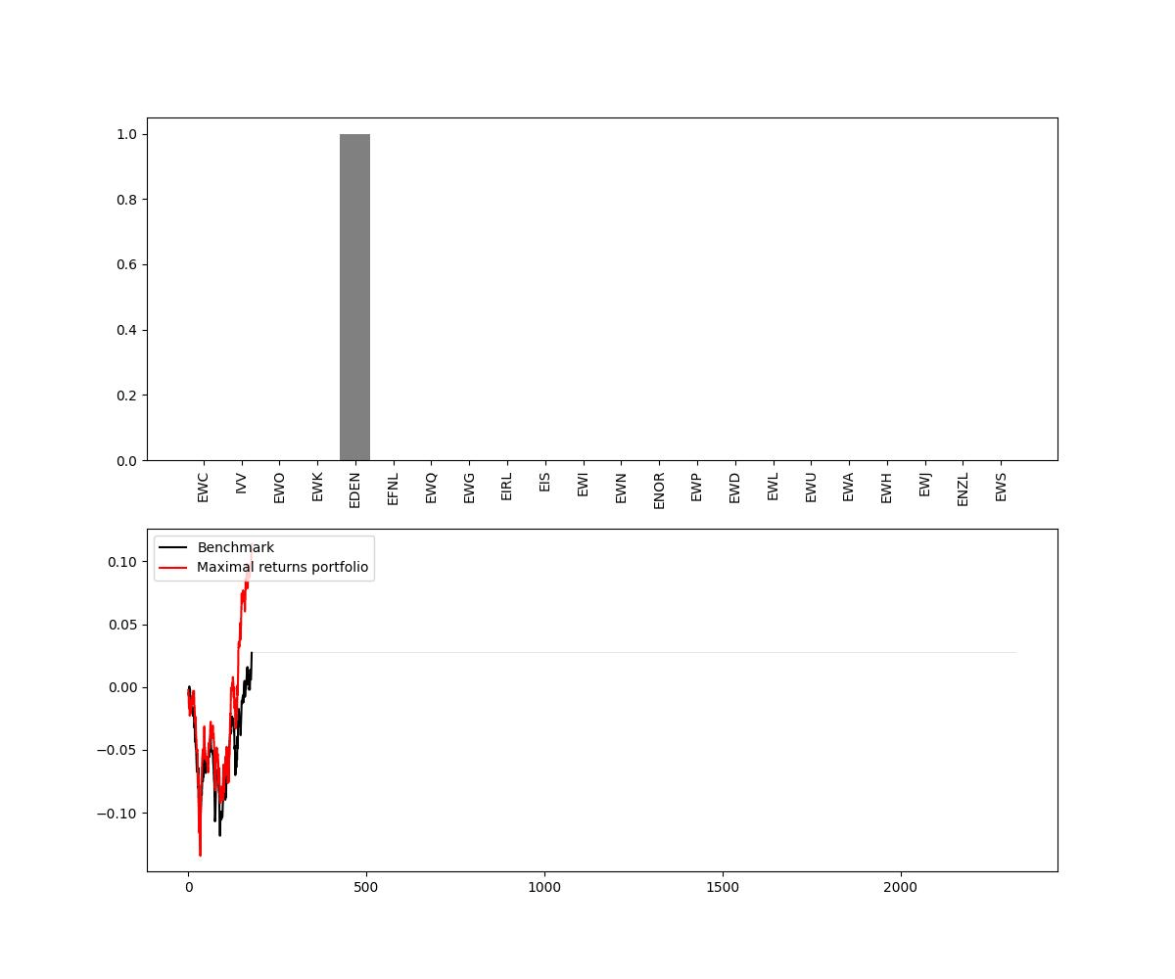
Maximal Returns Results
The solution is trivial: to allocate all the budget to the asset with maximum return.
Lacks diversification because only 1 stock is picked at any given period.

Slide 7
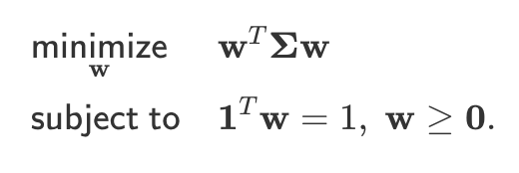
Classical Model 2: Minimum Variance
Here, Σ is the covariance matrix and the first condition identifies the collection of stocks with the least variance.
The second condition ensures complete investment of our capital, with no shorts.

Slide 8
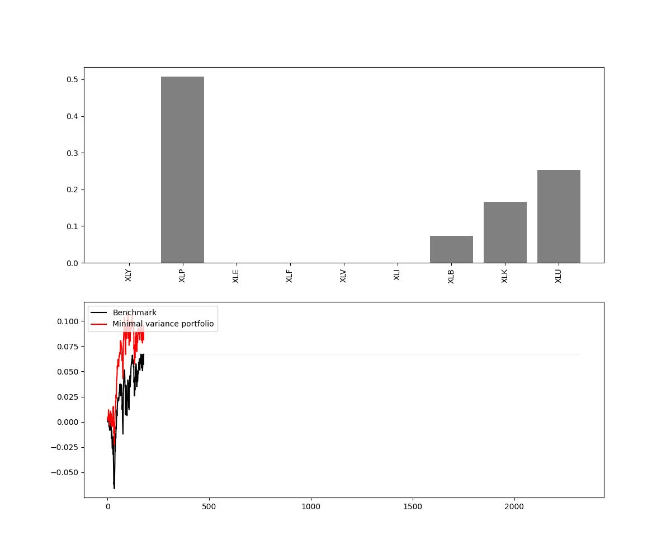
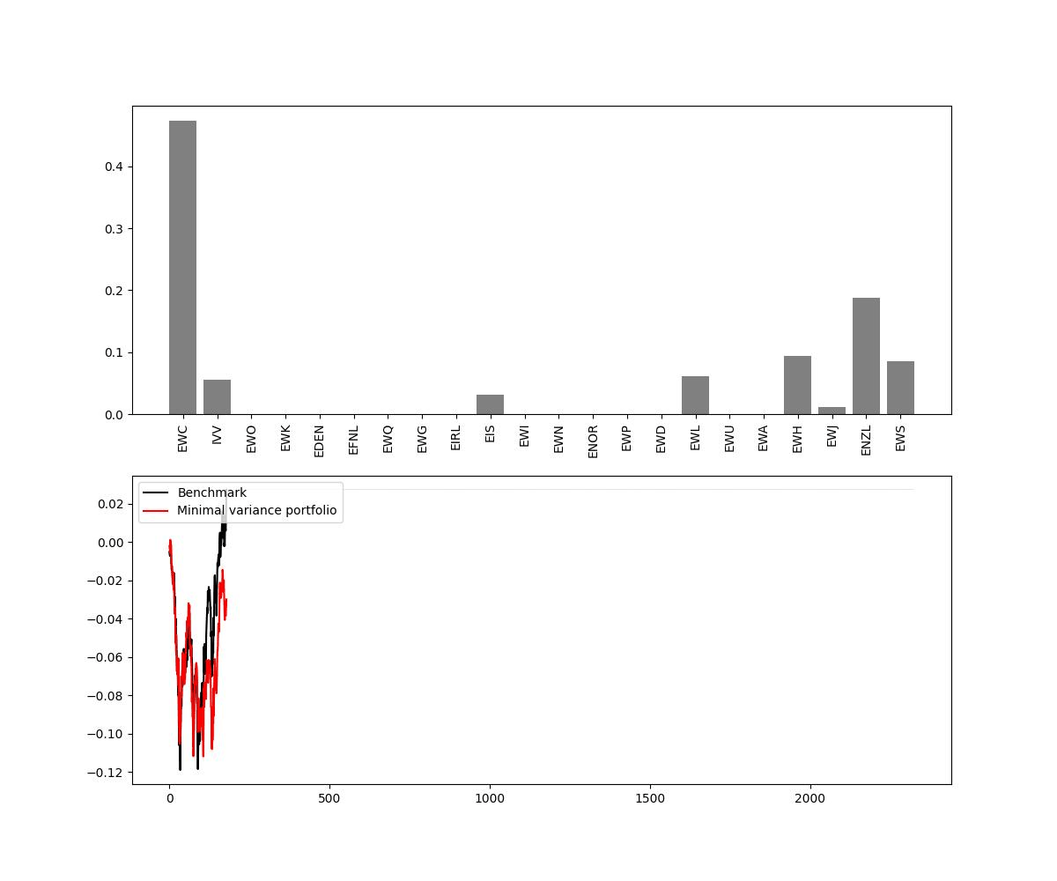
Minimum Variance Portfolio
The MVP encourages diversification by combining assets with low or negative correlations. Diversification can help reduce the risk associated with individual assets, as losses in one investment may be offset by gains in another.
If the optimization process is based on historical data, there is a risk of overfitting the portfolio to past market conditions. This can result in suboptimal performance when market dynamics change.

Slide 9
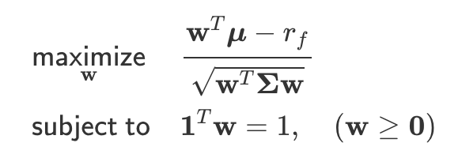
Classical Model 3: Maximum Sharpe Ratio
This type of Optimisation belongs to the class of fractional programming (FP) as it is not a convex problem.
To solve it, we used a non linear SLSQP (sequential least squares programming) method.

Slide 10
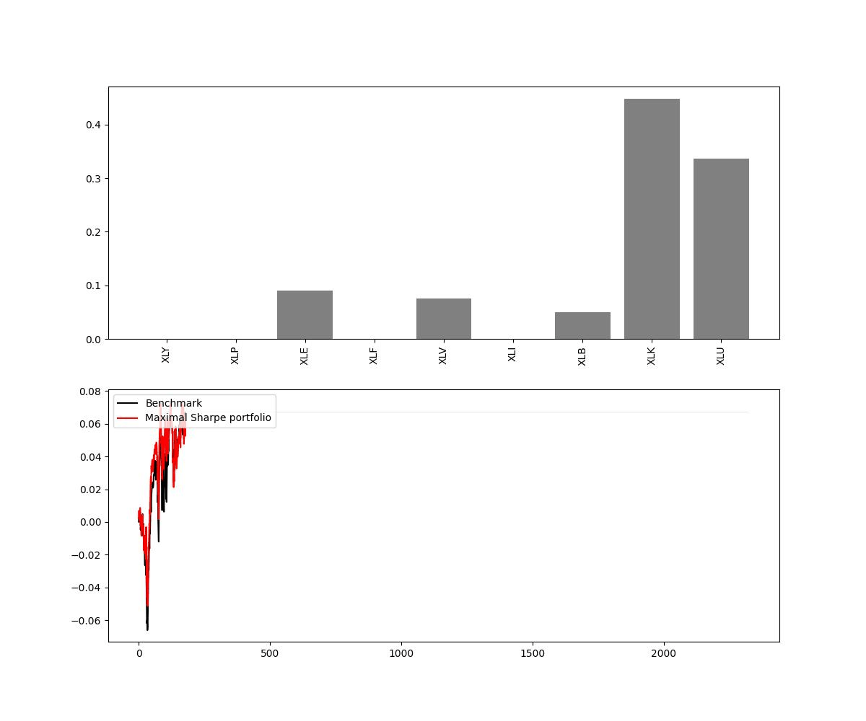
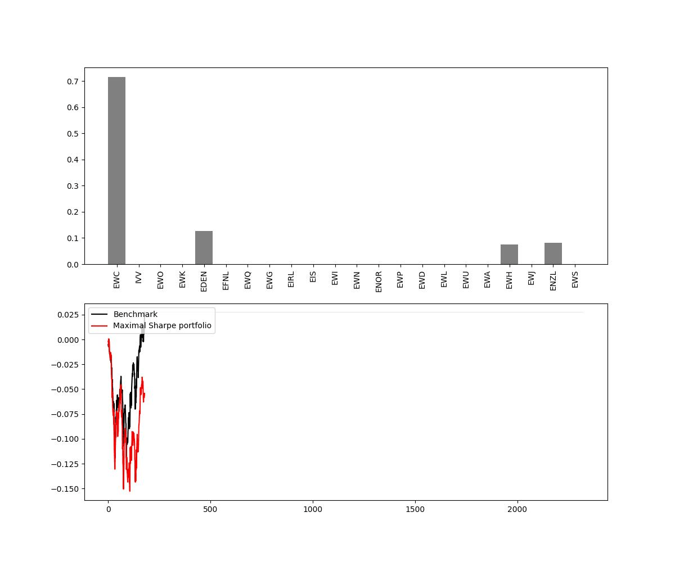
Maximum Sharpe Ratio
The MSR Portfolio is most sensitive to the assumption that the returns of the assets in the portfolio follow a normal distribution. In reality, financial markets often exhibit non-normal behaviour, and extreme events can occur more frequently than predicted.
However, the MSR is still the most widely used Portfolio either to invest in, or as a benchmark.

Slide 11
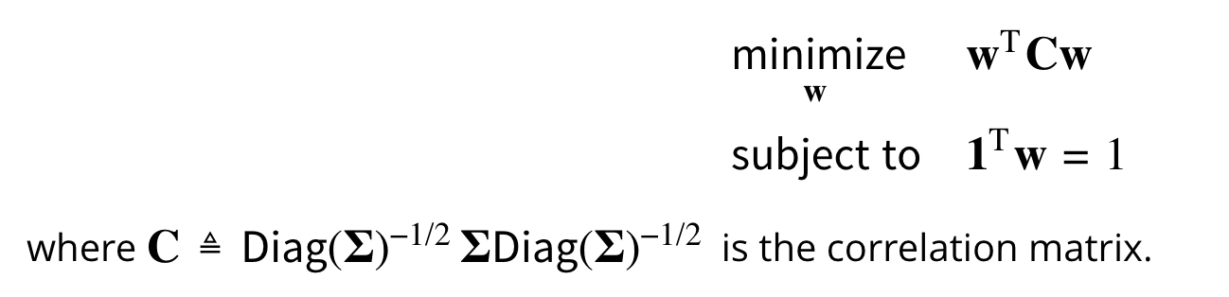
Classical Model 4: Maximum Decorrelation
The Maximum Decorrelation Portfolio (MDP) is closely related to MVP (Minimum Variance Portfolio) and the MDP (Maximum Diversity Portfolio), but applies to the case where an investor believes all assets have similar returns and volatility, but heterogeneous correlations.

Slide 12
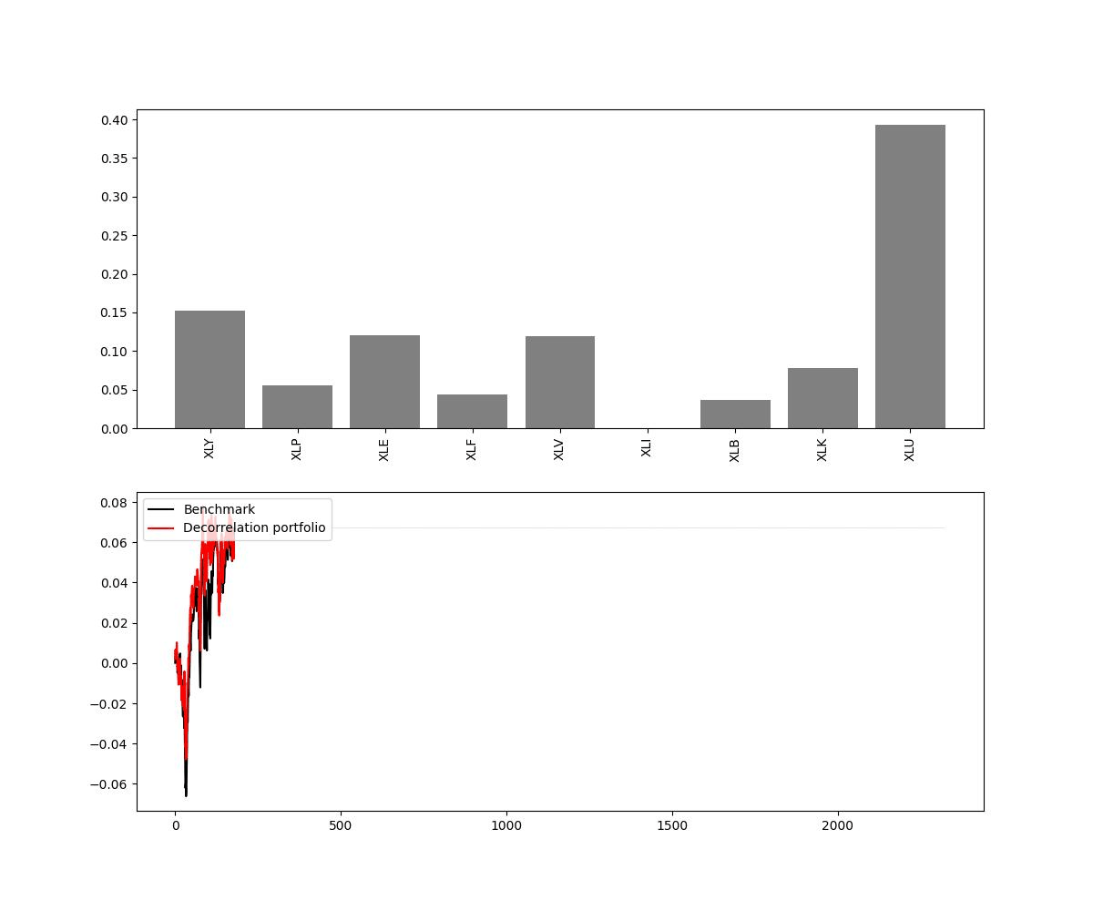
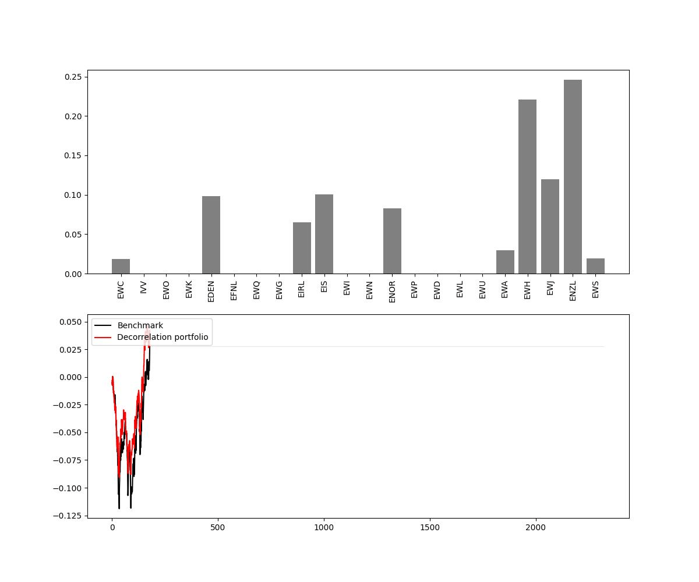
Maximum Decorrelation Portfolio
MDP maximizes the Decorrelation Ratio when all assets have equal volatility
MDP maximizes the Sharpe Ratio when all assets have equal risks and returns.

Slide 13
Machine Learning Models
Principal Component Analysis
Hierarchical Risk Parity
Holt-Winters Smoothing
Autoencoder

Slide 14
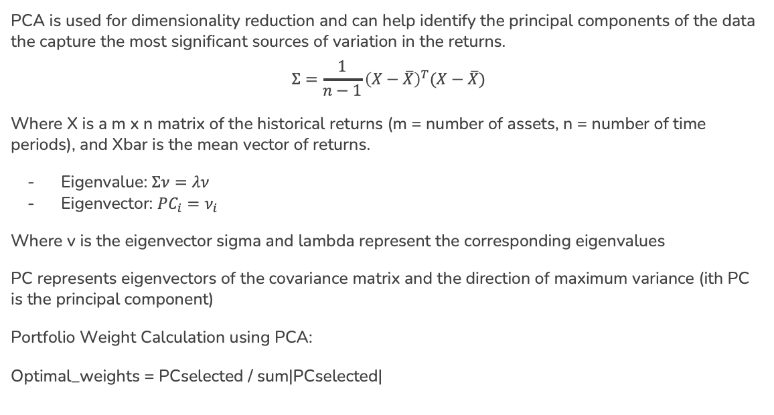
ML Model 1: Principal Component Analysis

Slide 15
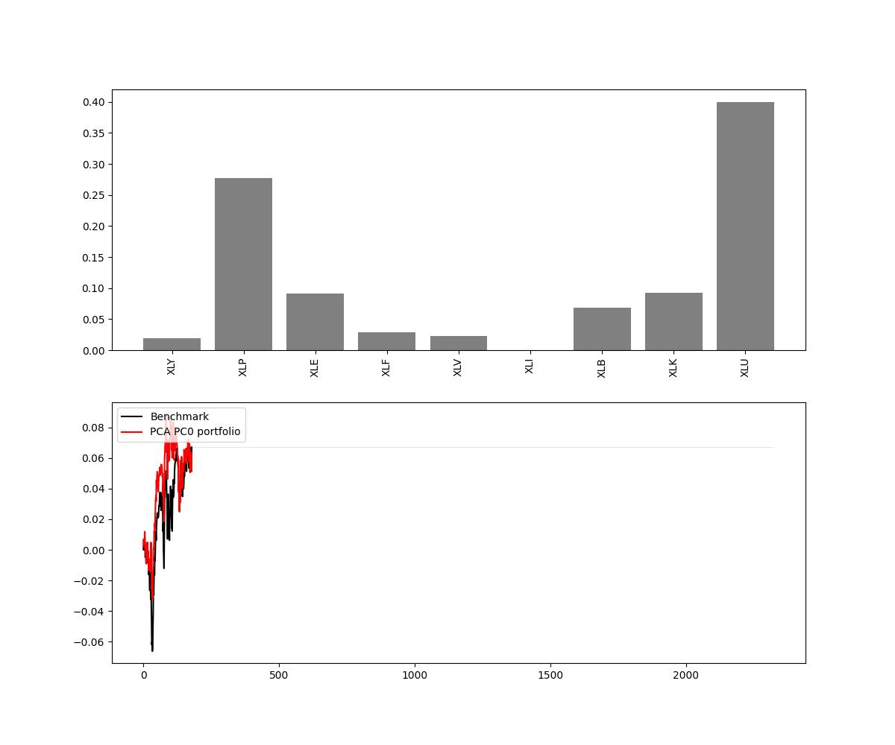
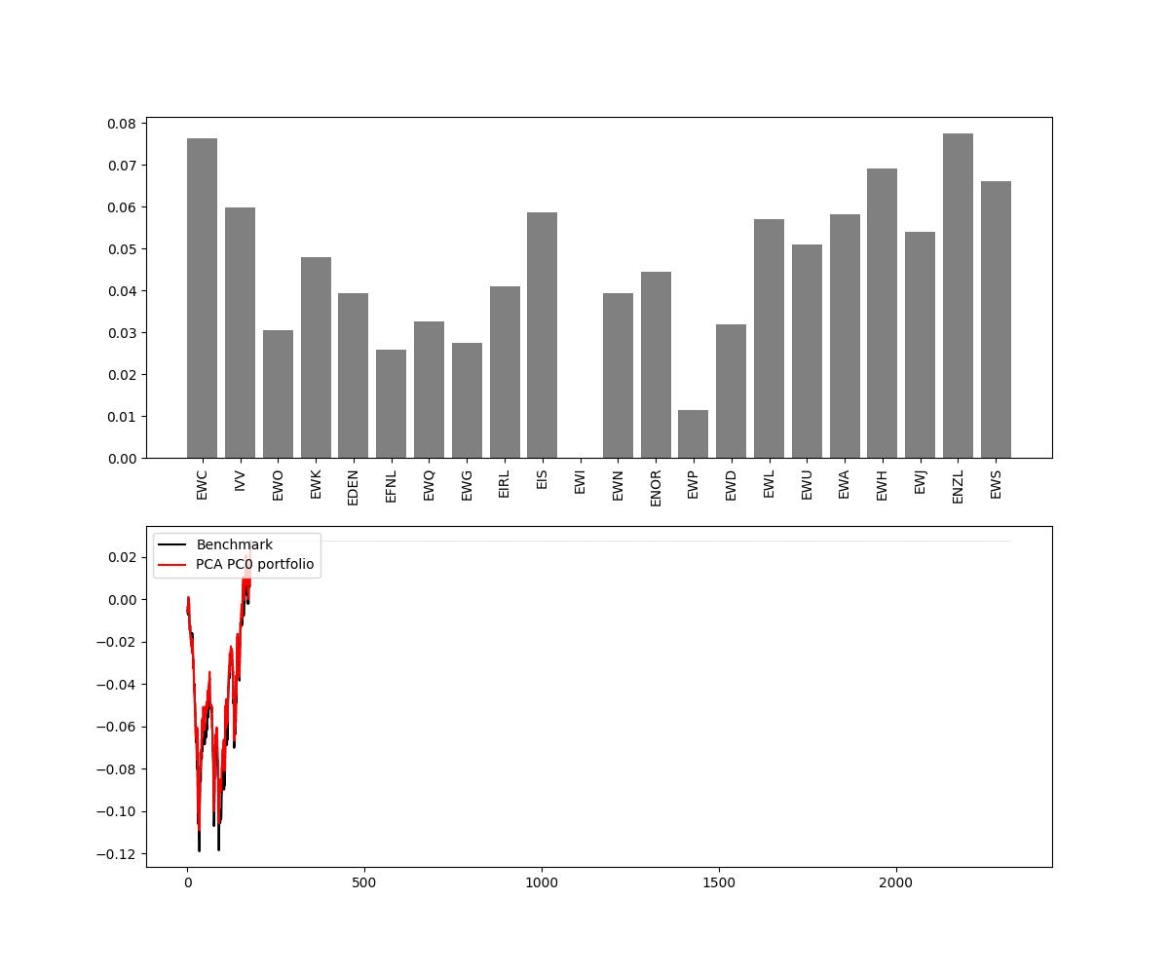
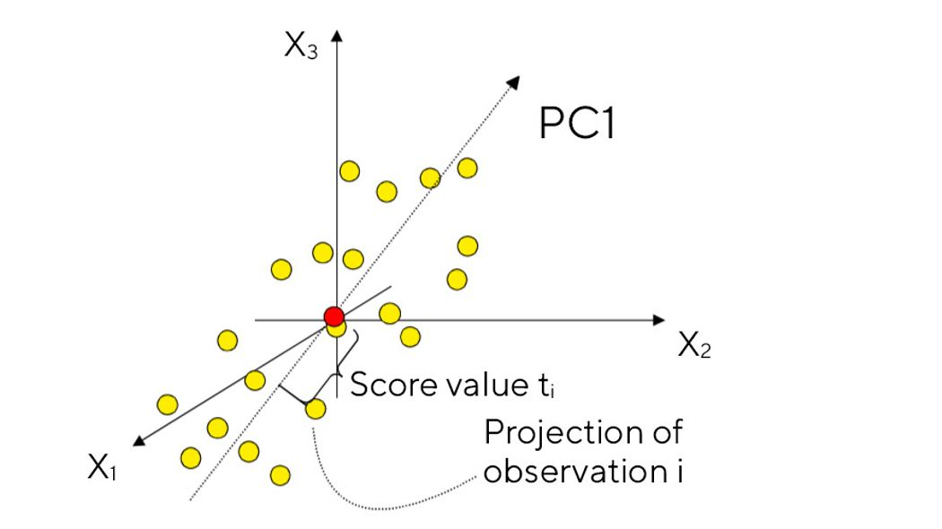
Principal Component Analysis
In this case we are using PC1, the first principal component.
The first principal component (PC1) is the line that best accounts for the shape of the point swarm. It represents the maximum variance direction in the data. Each observation (yellow dot) may be projected onto this line in order to get a coordinate value along the PC-line. This value is known as a score.

Slide 16
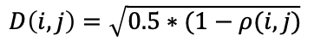
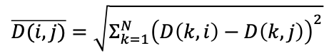
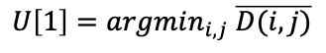
ML Model 2:Hierarchical Risk Parity
The correlation matrix is converted to a correlation-distance matrix D
HRP uses a hierarchical clustering algorithm to construct a diversified portfolio by allocating weights to assets based on their correlation or covariance structure. The goal of HRP is to minimize the portfolio’s overall risk by distributing the risk among assets.

Slide 17
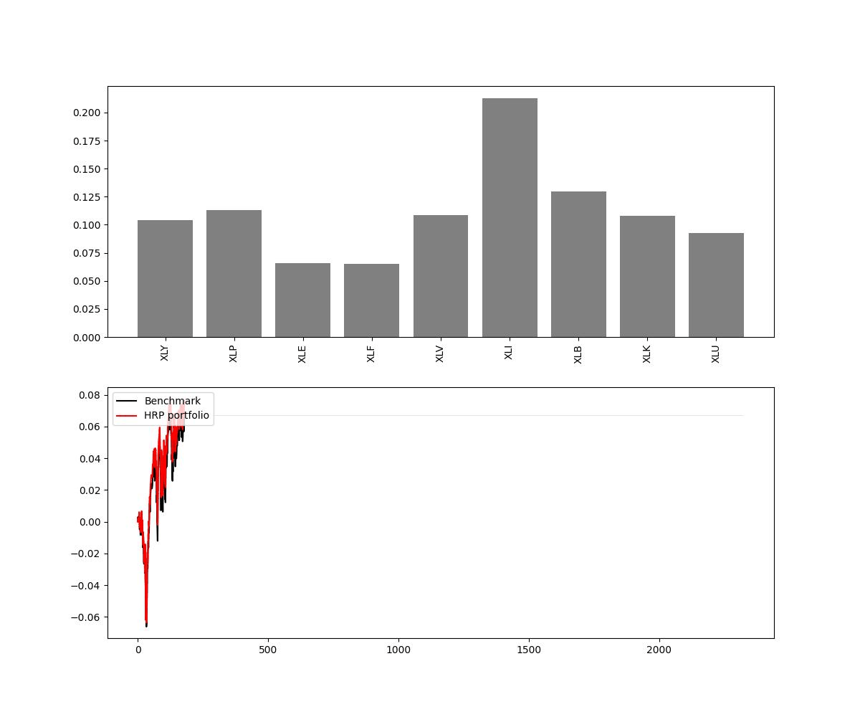
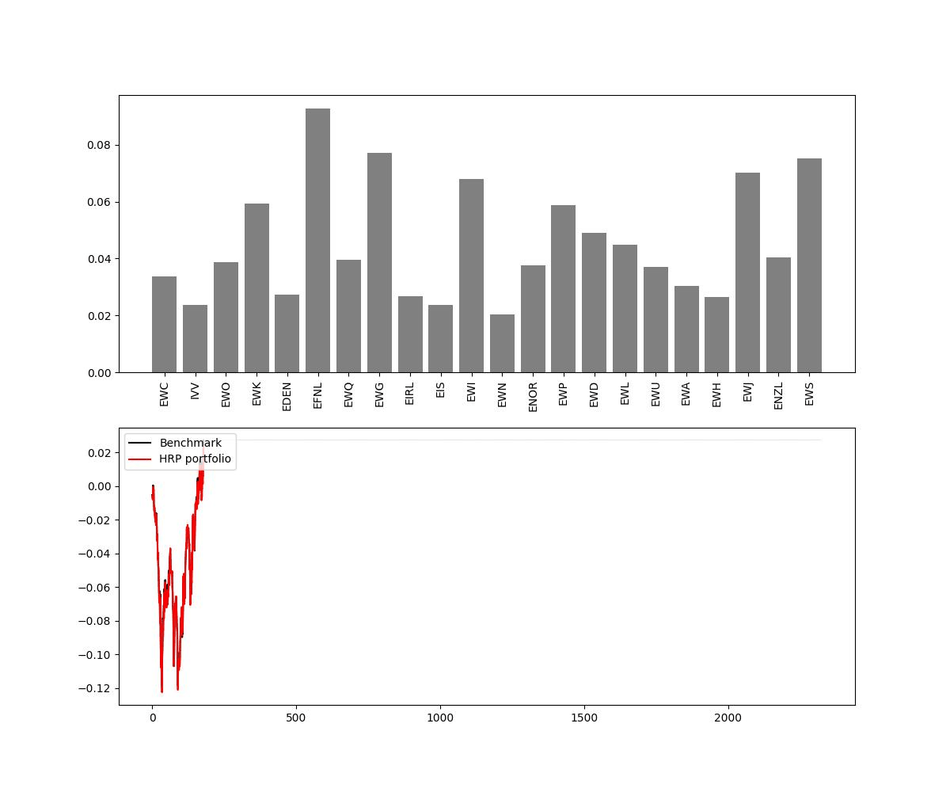
Hierarchical Risk Parity
HRP works in 3 steps:
Hierarchical Tree Clustering
Creating the dendrogram based on D_hat (i,j)
Matrix Seriation
rearrange the data to show the inherent clusters clearly.
Recursive Bisection
Assigning the weights

Slide 18
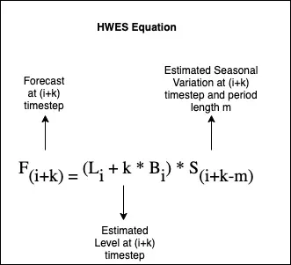
ML Model 3: Holt-Winters Smoothing
The Holt-Winters smoothing technique leverages exponential smoothing methods to dynamically adjust asset weights in response to historical time series data in order to achieve the best possible risk-adjusted return.
The optimized portfolio is then constructed by selecting a subset of assets based on the forecasts generated by the Holt-Winters model, emphasizing assets with favorable risk-return profiles.

Slide 19
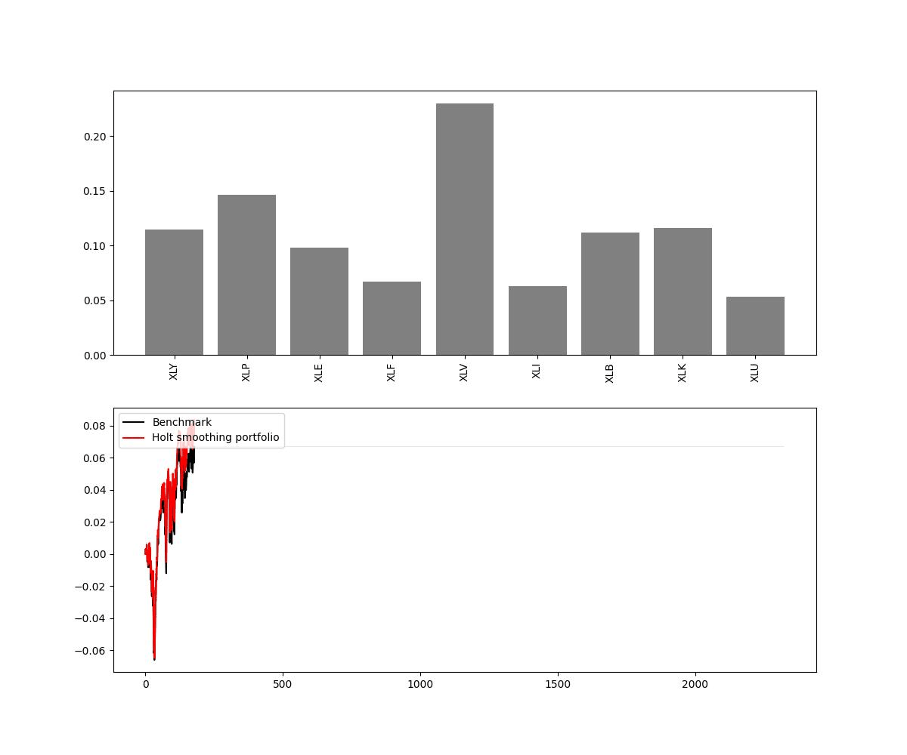
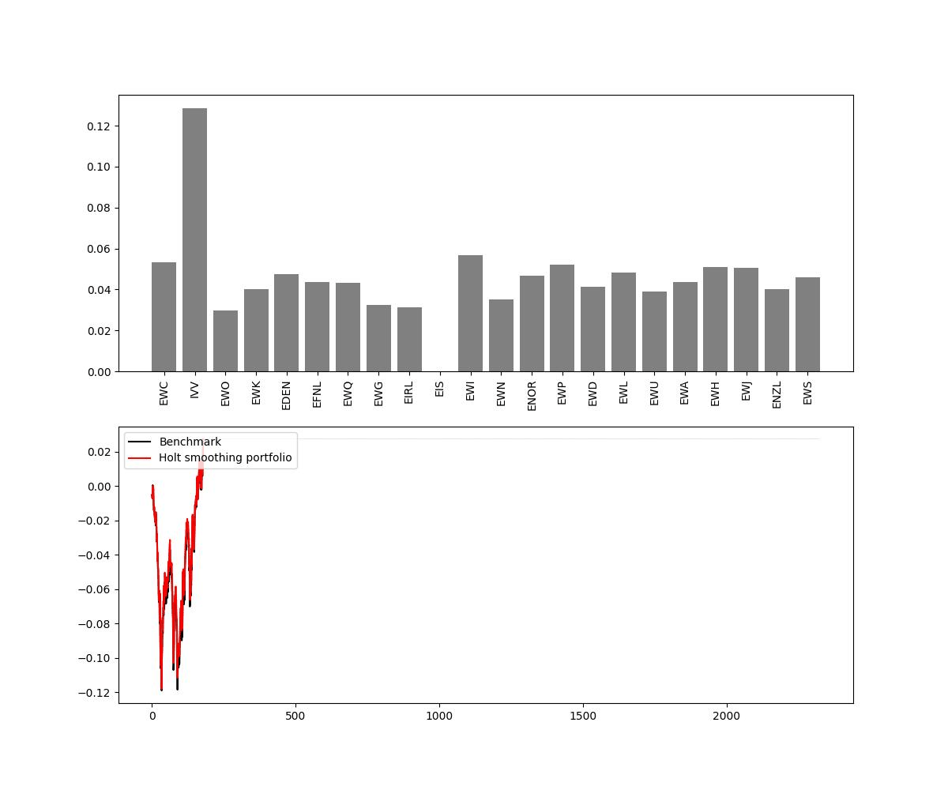
Holt-Winters Smoothing
The Holt-Winters ES modifies the Holt ES technique so that it can be used in the presence of both trend and seasonality.
It estimates the 4 aspects of time series data:
Level
Trend
Seasonality
Noise

Slide 20
ML Model 4: Autoencoder
Autoencoder steps:
Encoding/Compression: The encoder takes the input data and maps it to a lower-dimensional representation. This compressed representation is known as the bottleneck or latent space and captures the most important features of the input data.
Decoding: The decoder takes the compressed representation of the latent space and reconstructs the original input data, aiming to generate minimize the difference between the input data and the reconstructed output using a loss function.
The optimal weights for the portfolio are determined based on the communal information and differences between the input data and the reconstructed data.

Slide 21
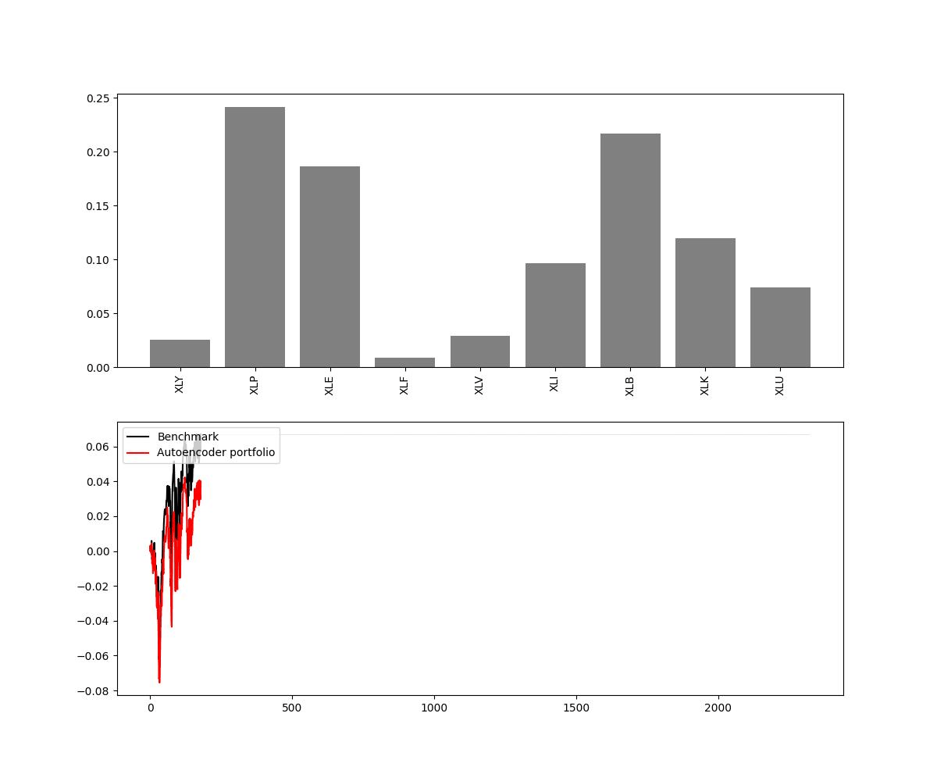
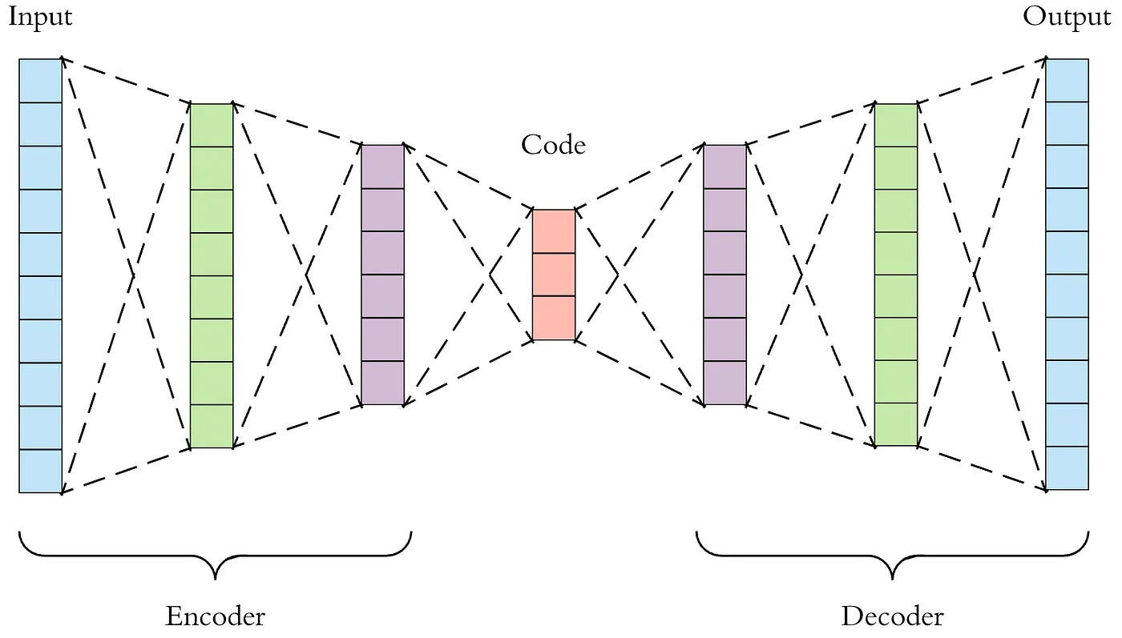
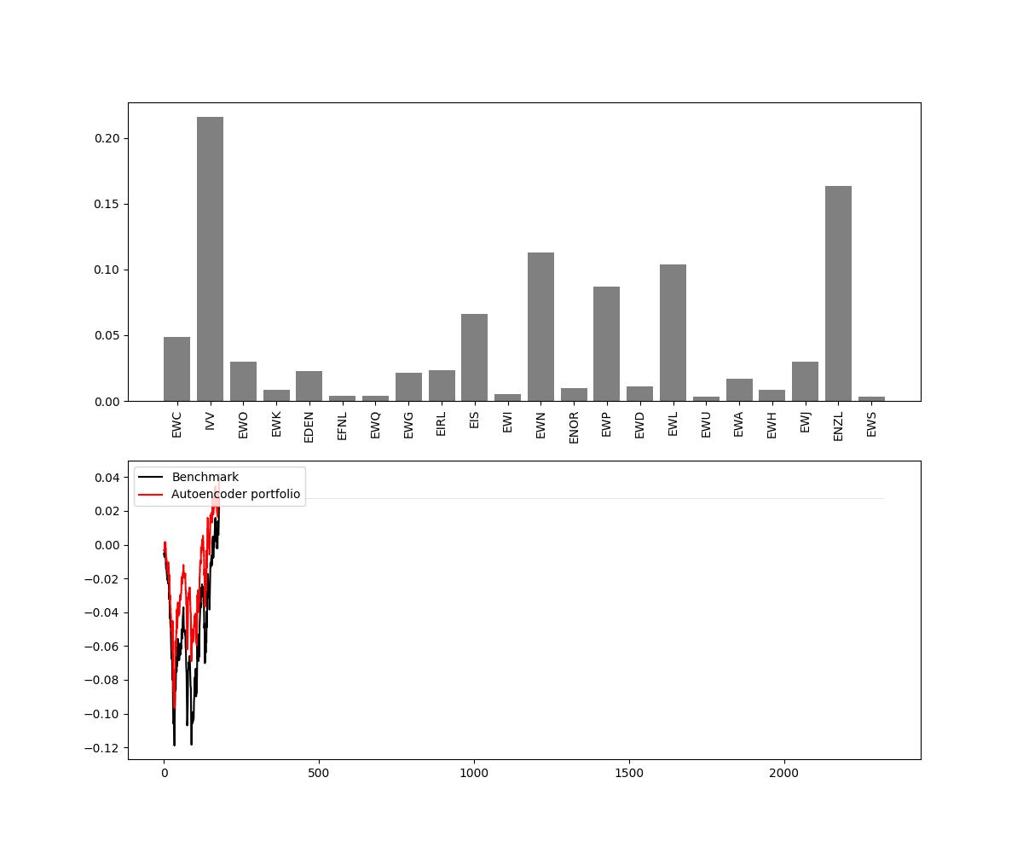
Autoencoder
In this implementation, we go from 180 data points, to 25 and back to 180 between the encoder and decoder layer.
For the encoder, the activation function is ReLu, and for the decoder it is Linear.
The optimiser function to choose the weights is MSE (mean squared error).

Slide 22
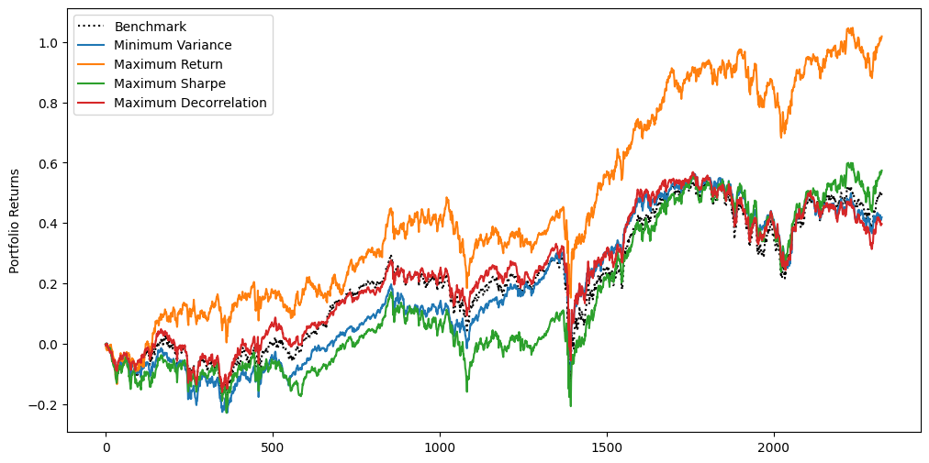
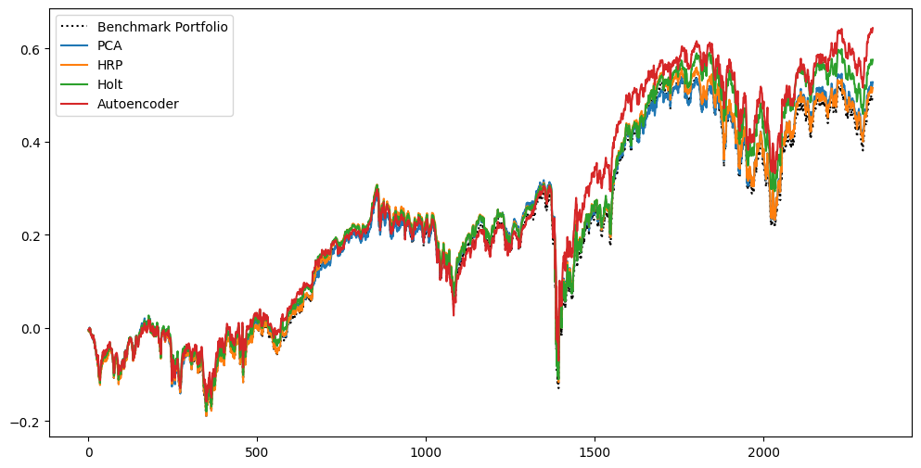
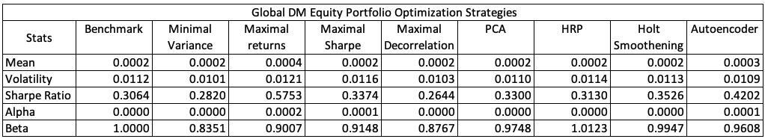
Results (Global Equity) (2013-2023)

Slide 23
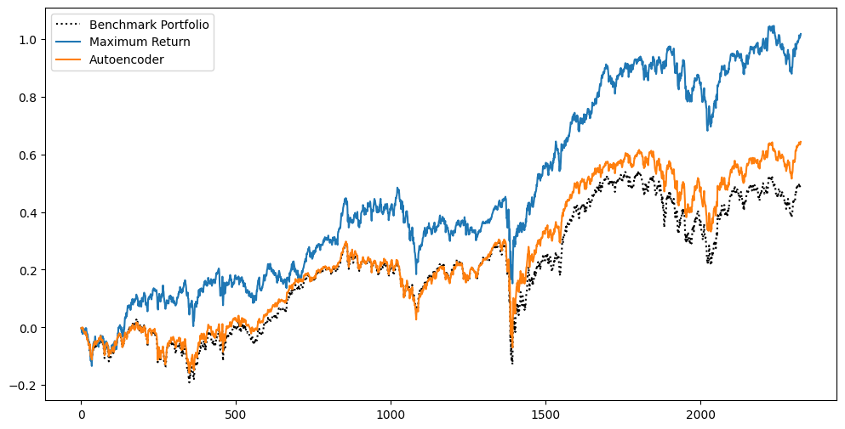
Results (Global Equity) (2013-2023)
101.84%
(7.28%)
66.94%
(5.26%)
49.88%
(4.13%)

Slide 24
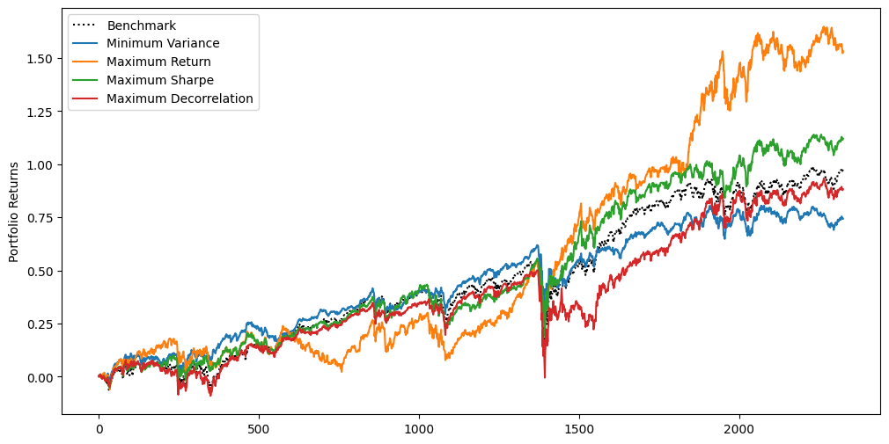
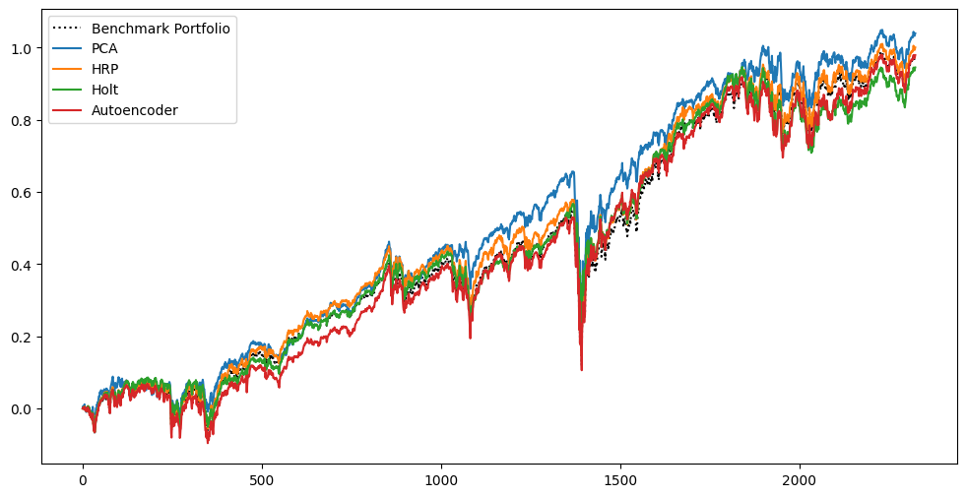
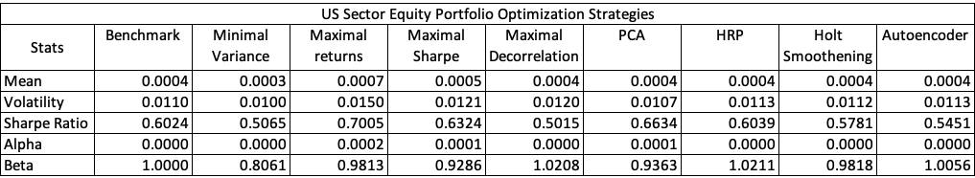
Results (US Sector ETFs) (2013-2023)

Slide 25
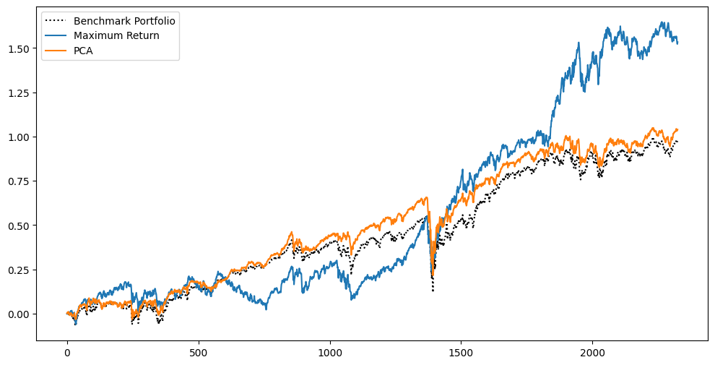
Results (US Sector ETFs) (2013-2023)
153.29%
(9.74%)
103.95%
(7.39%)
97.44%
(7.04%)

Slide 26
Conclusion
The idea of this project is to compare Classical Markowitz Portfolio Optimisation techniques with more modern Machine Learning algorithms.
Markowitz Model heavily depends on historical data, which may not reliably predict future market trend, hence the ML models incorporate an aspect of Forecasting in its predictions.

Slide 27
References
Alex, Honchar. ”AI for portfolio management: from Markowitz to Reinforcement Learning.” September 28th, 2019. https://medium.com/neurons-lab/ai-for-portfolio-management-from-markowitz-to-reinforcement-learning-cffedcbba566. December 2023.
Conlon, Thomas, John Cotter och Iason Kynigakis. ”Machine Learning and Factor-Based Portfolio Optimization.” July 8th, 2021. https://arxiv.org/pdf/2107.13866.pdf. December 2023.
Lim, Qing, Qi Cao och Chai Quek. ”Dynamic portfolio rebalancing through reinforcement learning.” 2022. https://link.springer.com/article/10.1007/s00521-021-06853-3. December 2023.
Ranchnog. ”Deep-Portfolio-Management.” September 27th, 2019. GitHub. December 2023.
Reed, Eric. ”A Guide to Portfolio Optimization Strategies.” March 3rd, 2023. https://smartasset.com/investing/guide-portfolio-optimization-strategies. December 2023.
ReSolve Asset Management. "Portfolio Optimization: Simple Versus Optimal Methods." https://investresolve.com/portfolio-optimization-simple-optimal-methods/. December 2023.

